Slide 1
Accessible Development
End of module project

Slide 2
Objective
The objective of this assignment is to create a static web application using HTML, CSS, and Vanilla JavaScript that follows best practice with accessibility.
The assignment will focus on
utilizing developer tools that check accessibility features in web pages - allowing students to choose their own
subject features
design.
Each learner will be responsible for producing one web app, ensuring the validity of HTML5 structure, responsiveness of CSS, and clean and error-free JavaScript code, this is in combination with running the site through accessibility tools suchas WAVE / AXE Tools.

Slide 3
My web app
A web page on accessible webpage colour contrast

Slide 4
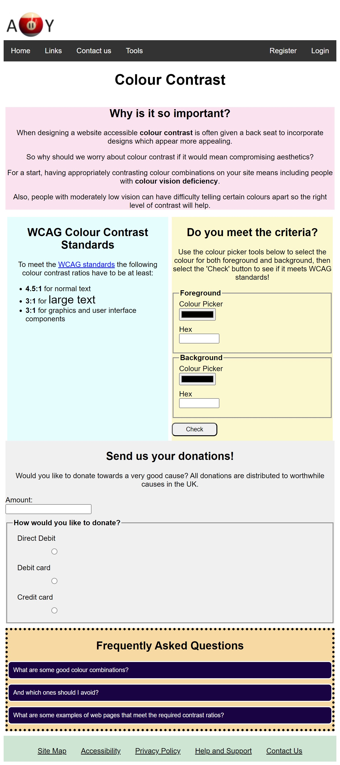
Full page view of the web app

Slide 5
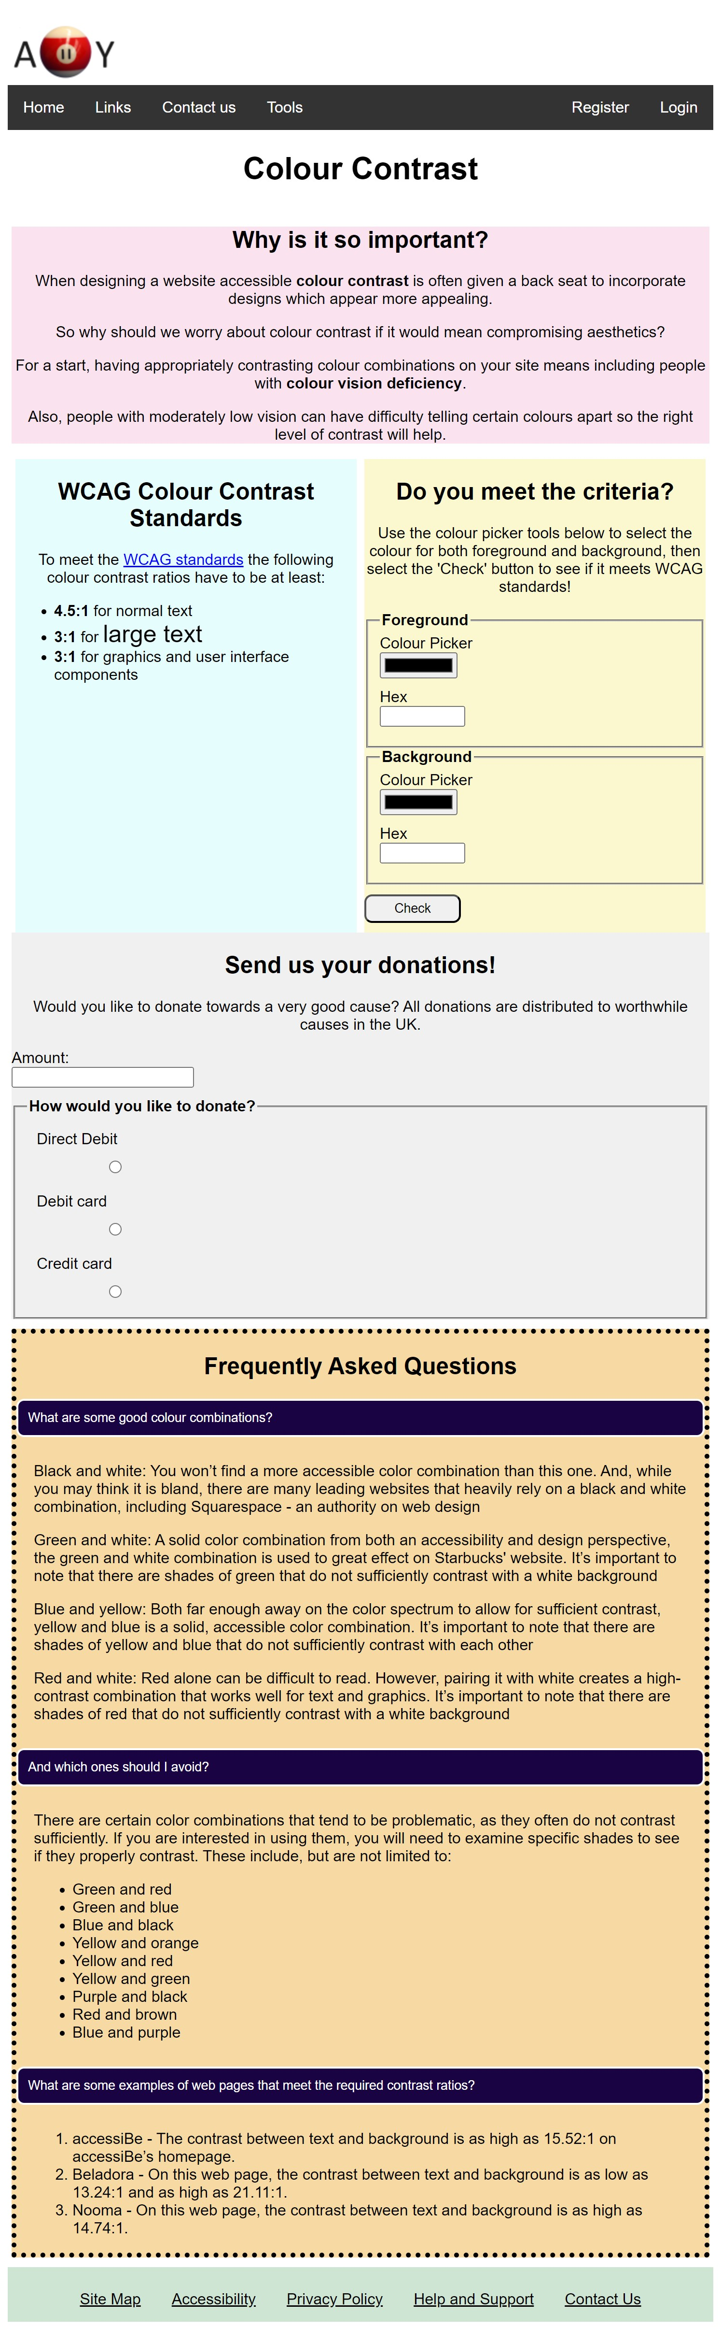
With FAQ accordions expanded

Slide 6
The next slide will show 3 screenshots, each with a different payment option expanded

Slide 7
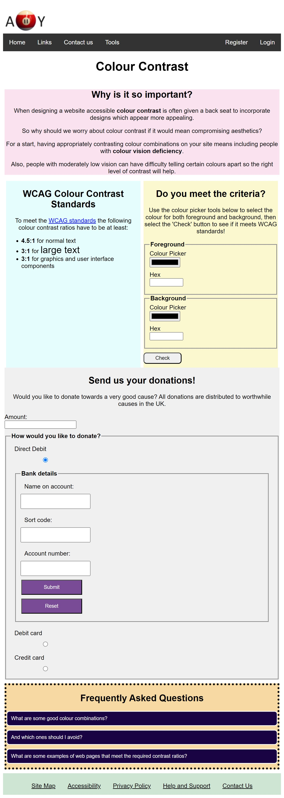
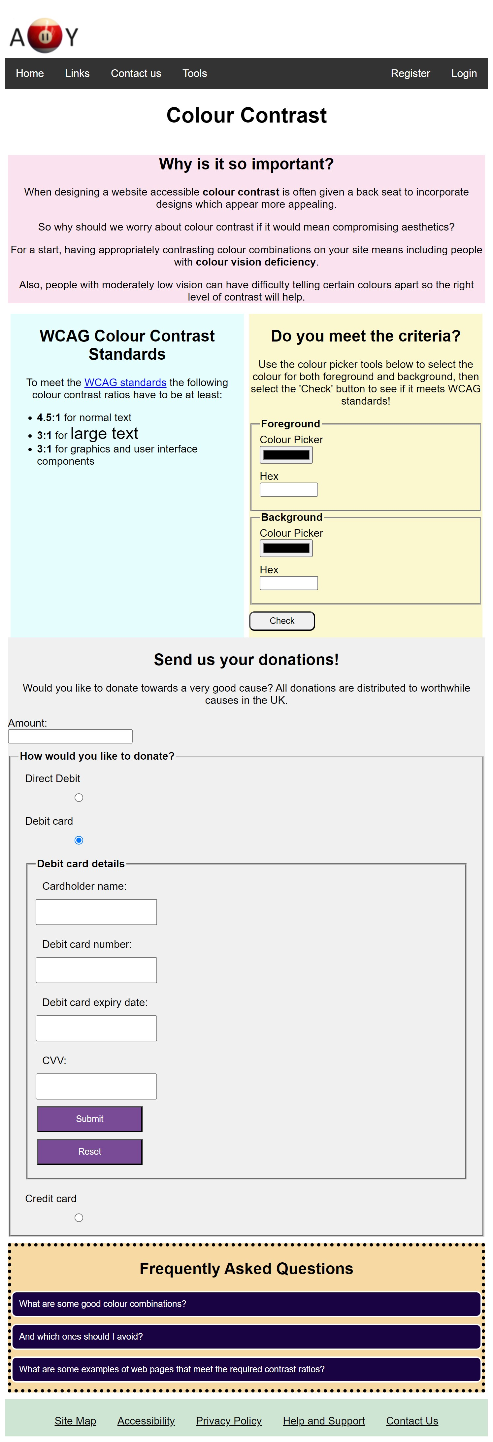
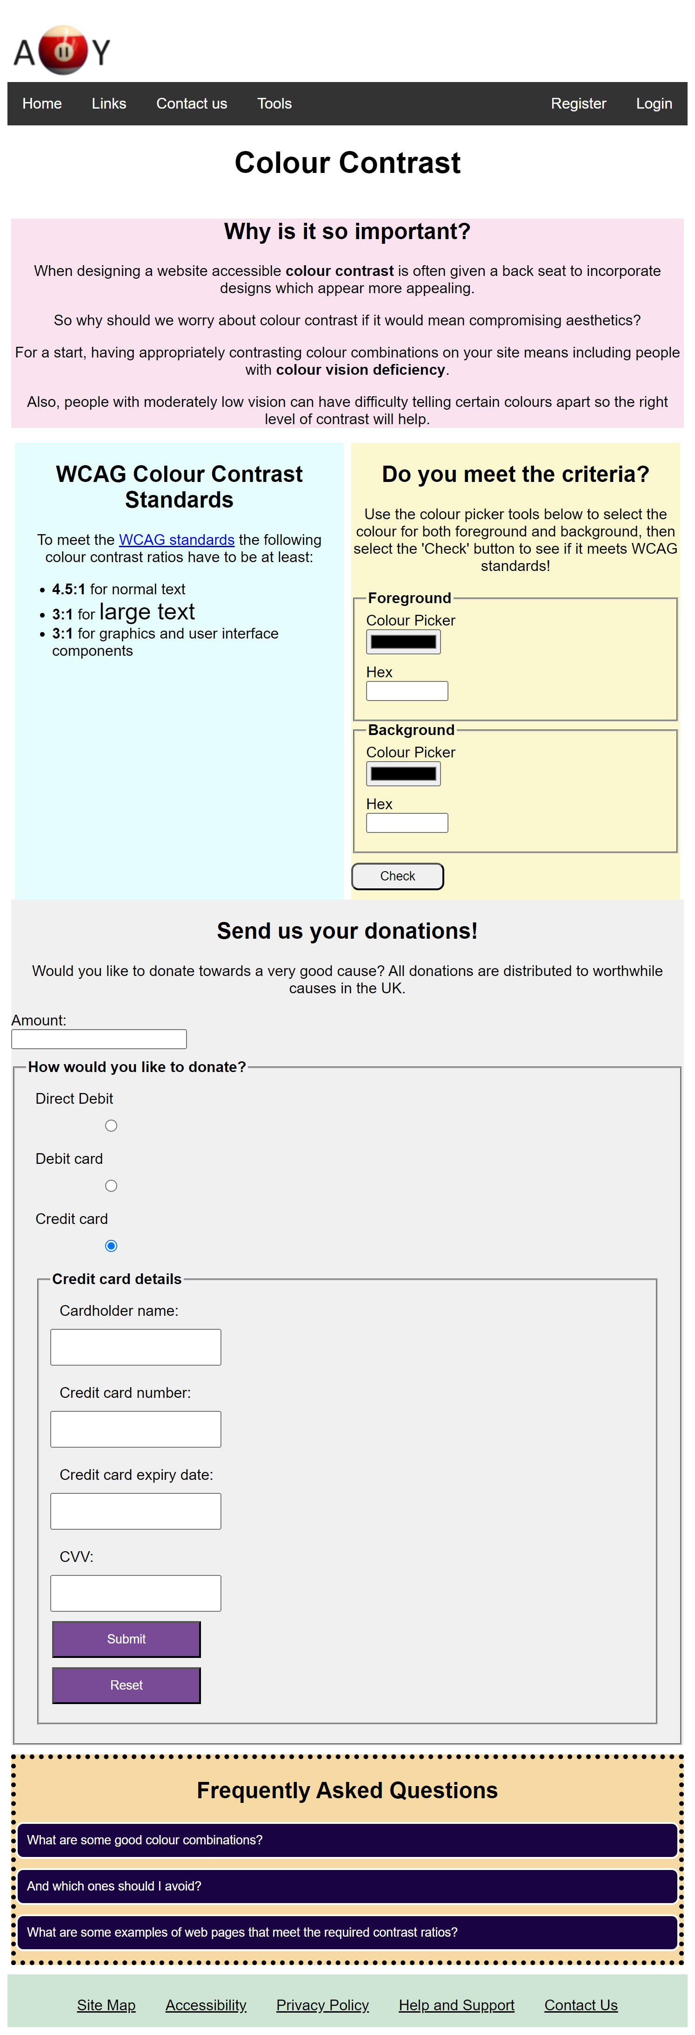

Slide 8
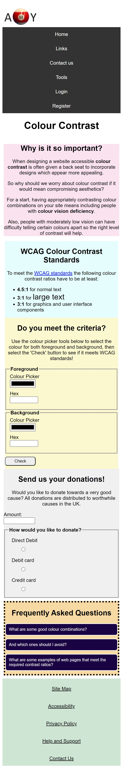
Mobile view

Slide 9
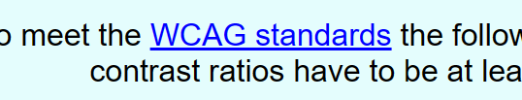
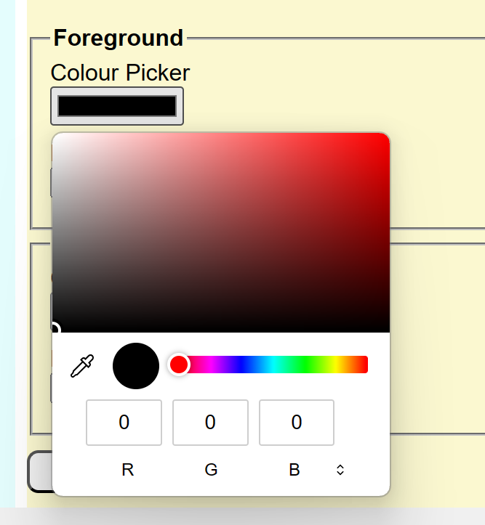
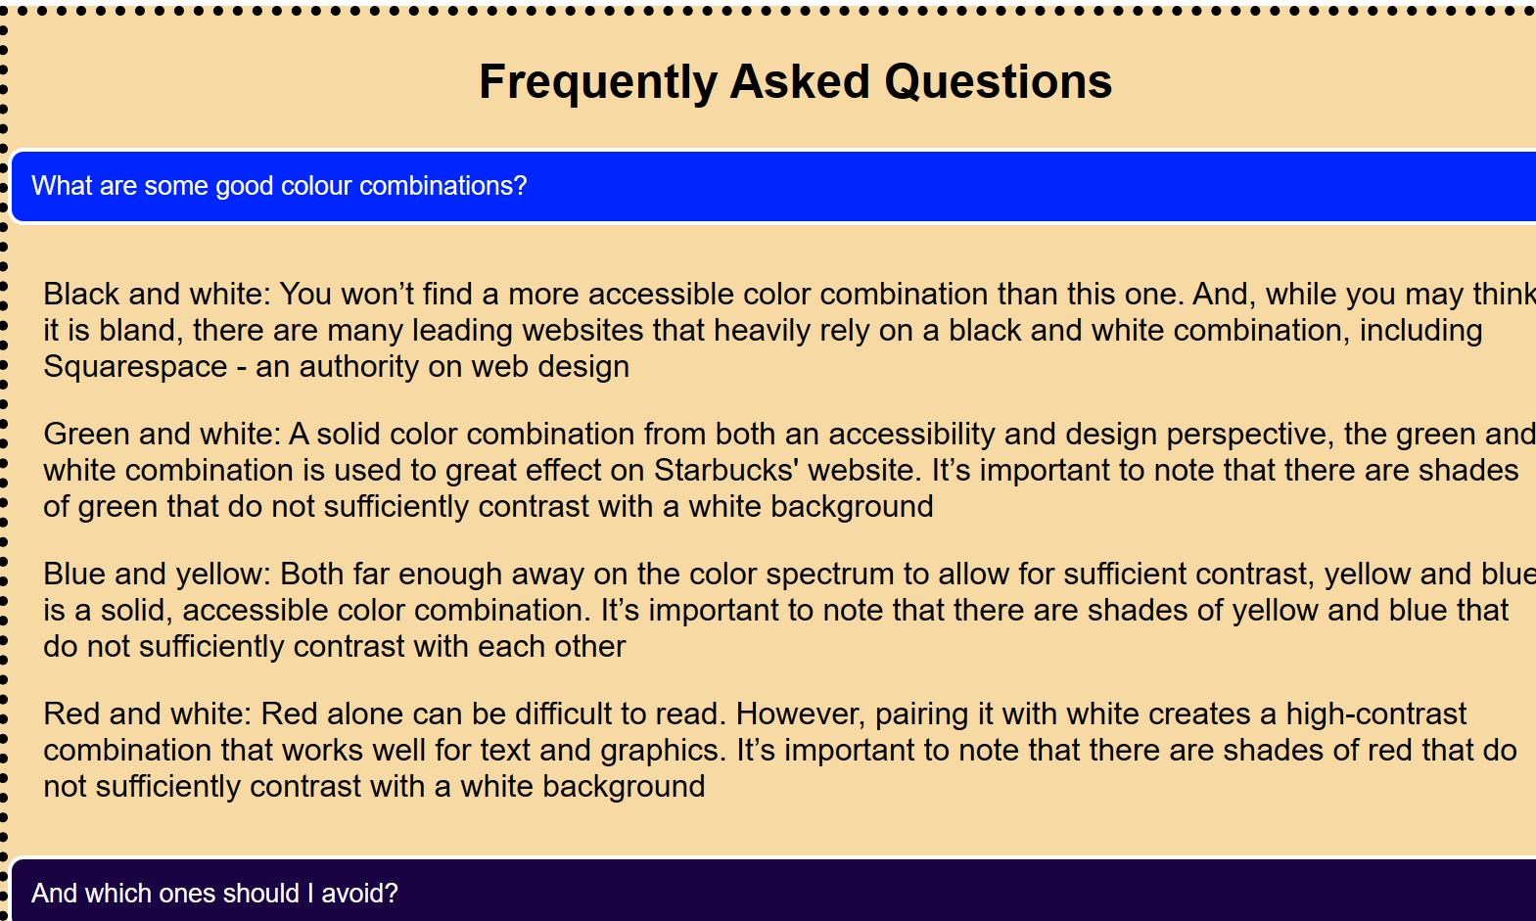
Features
Link
Colour picker
Accordion

Slide 10
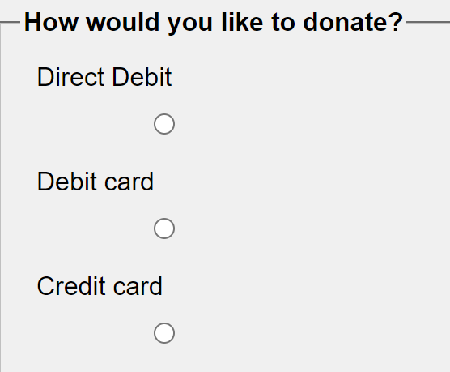
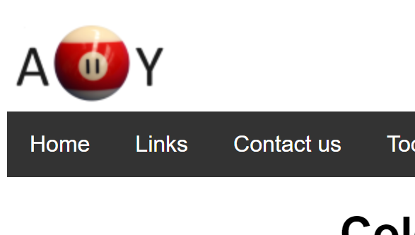
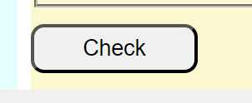
Features
Menu bar
Interactive logo
Button
Footer links
Radio buttons

Slide 11
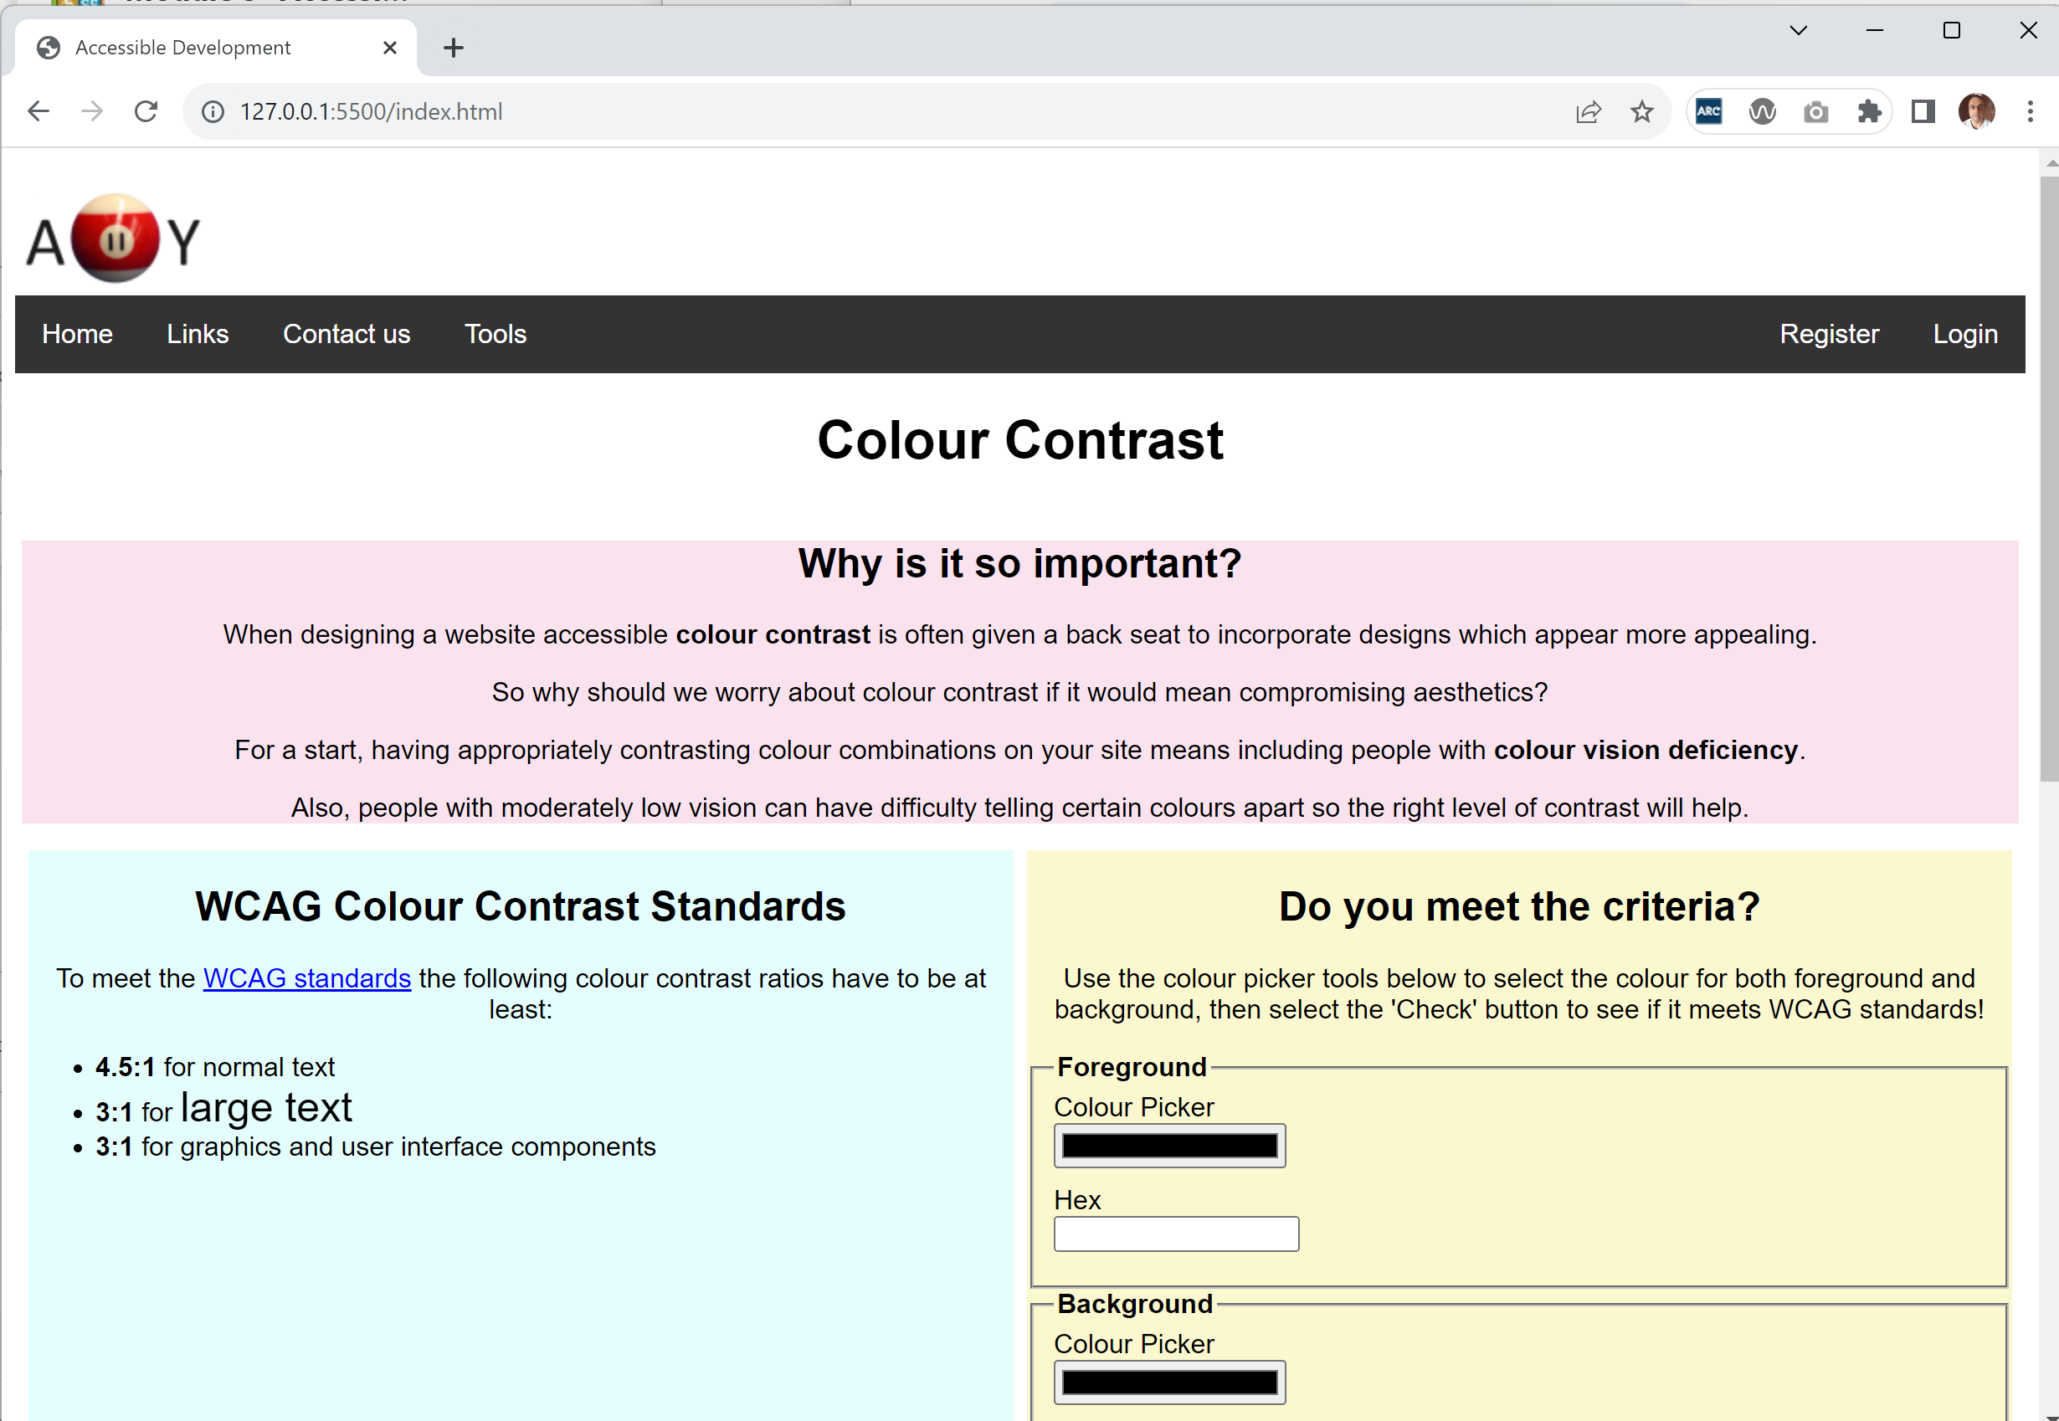
Design
Page title shows in tab
Logo in top left – first thing user sees when landing on page
Menubar across full width, with login/register on far right so separate from other menu options
Main heading at the top, so user knows what the page is about straightaway
Colours used to separate different sections of the page visually
Legend used to identify which form fields relate to which section

Slide 12
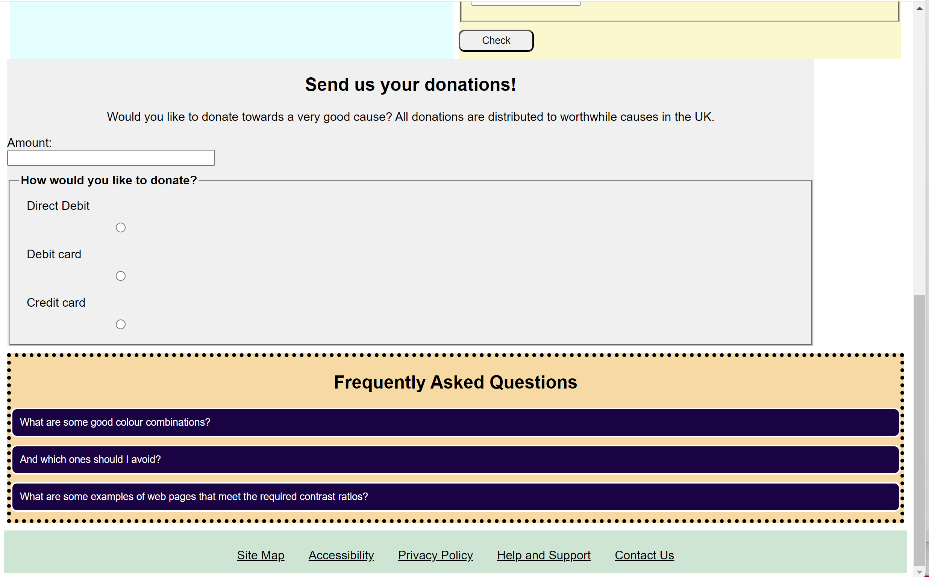
Design
Button to check colour contrast based on values entered by user
Text input field for user to input donation amount
Radio buttons for user to select method of payment
Accordions used for FAQs, that the user can expand for the answer
Footer section with links laid out in a row

Slide 13
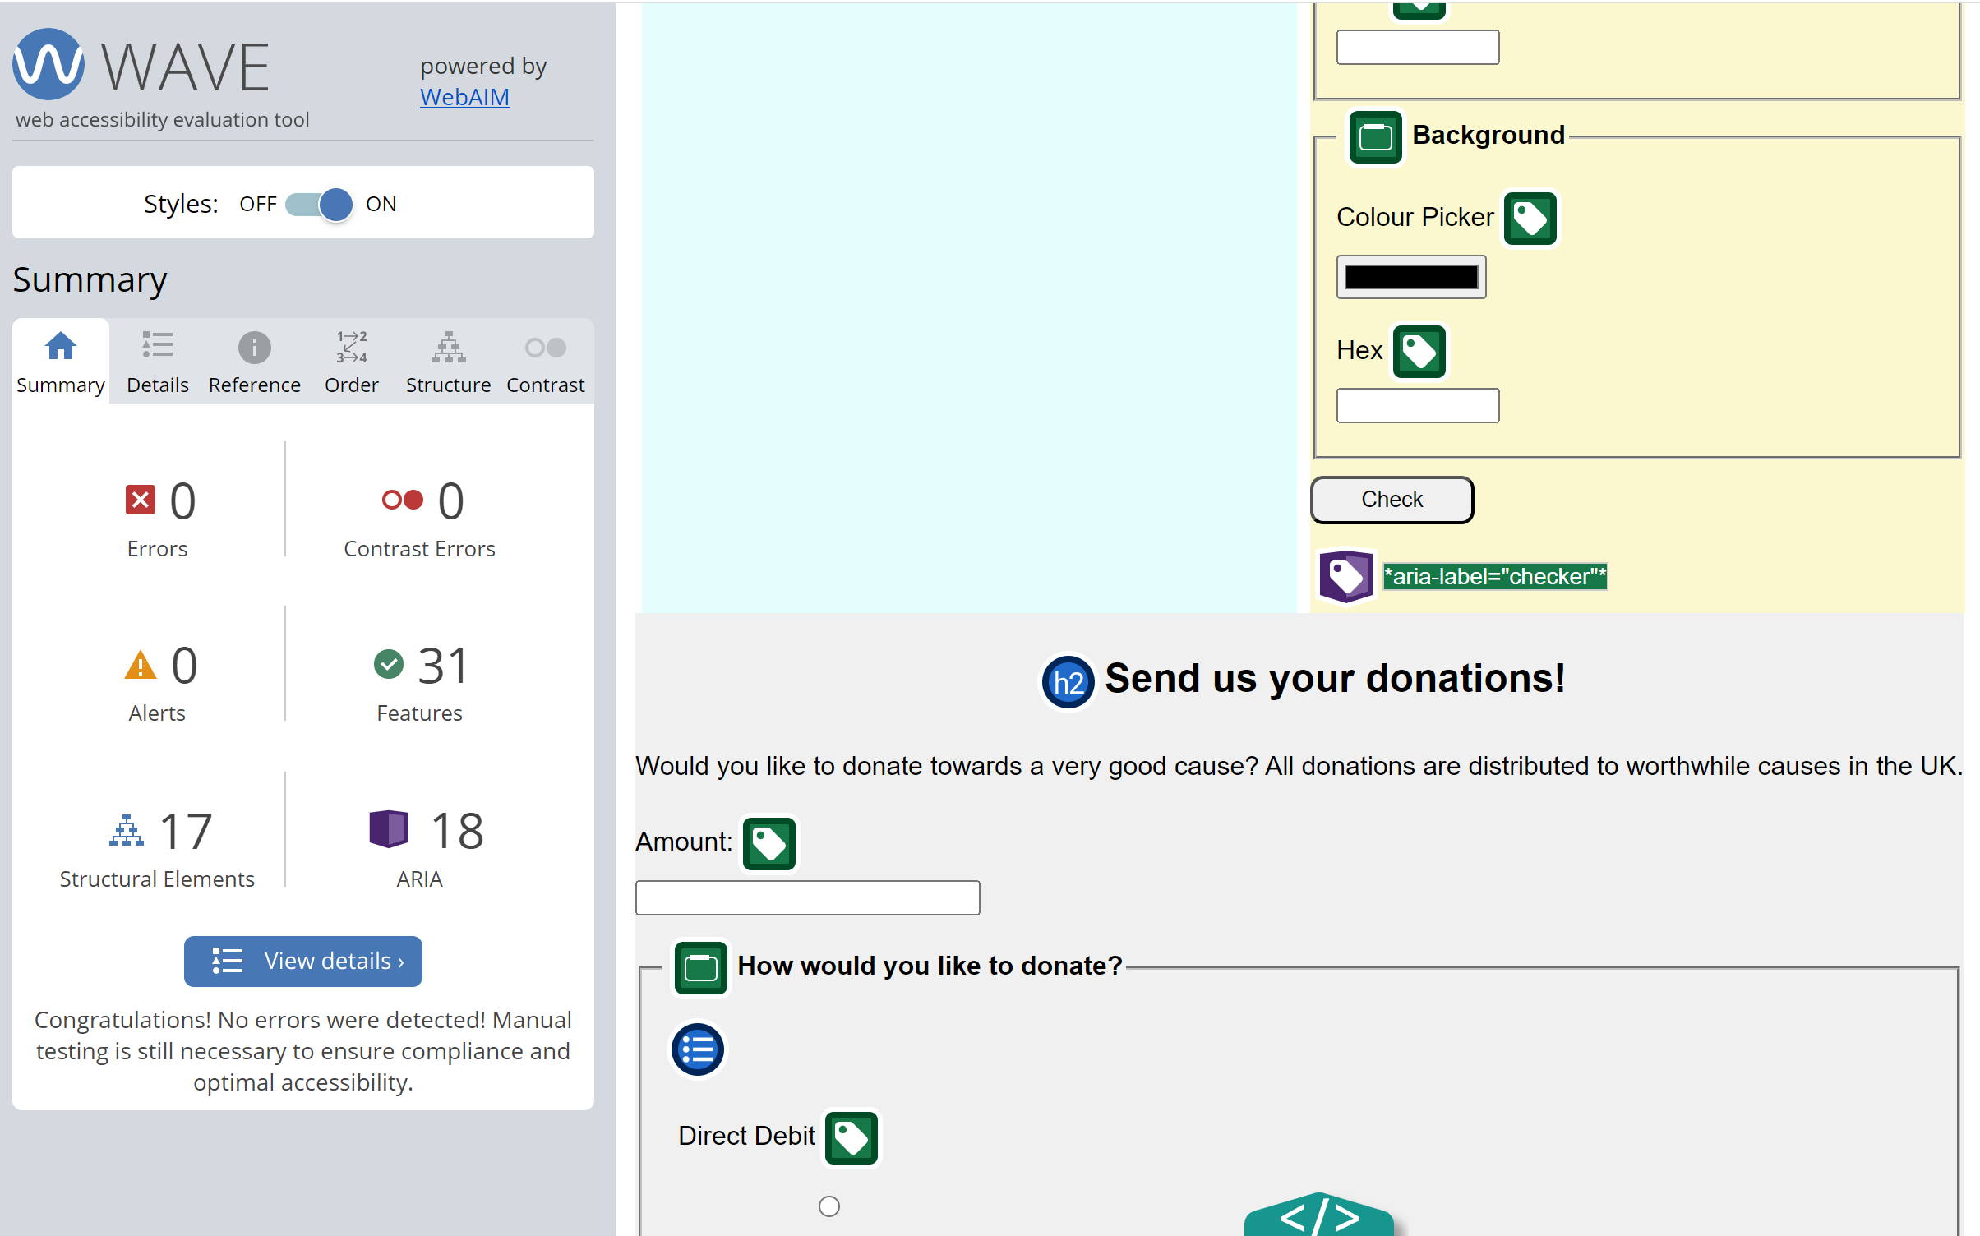
Accessibility – Automated Checker
After a few attempts I was able to get rid of all of the accessibility issues that were identified by the WAVE accessibility tool. I also utilised the ARC Toolkit Chrome plugin to deal with accessibility issues, due to my familiarity with it having used it many times at my work.

Slide 14
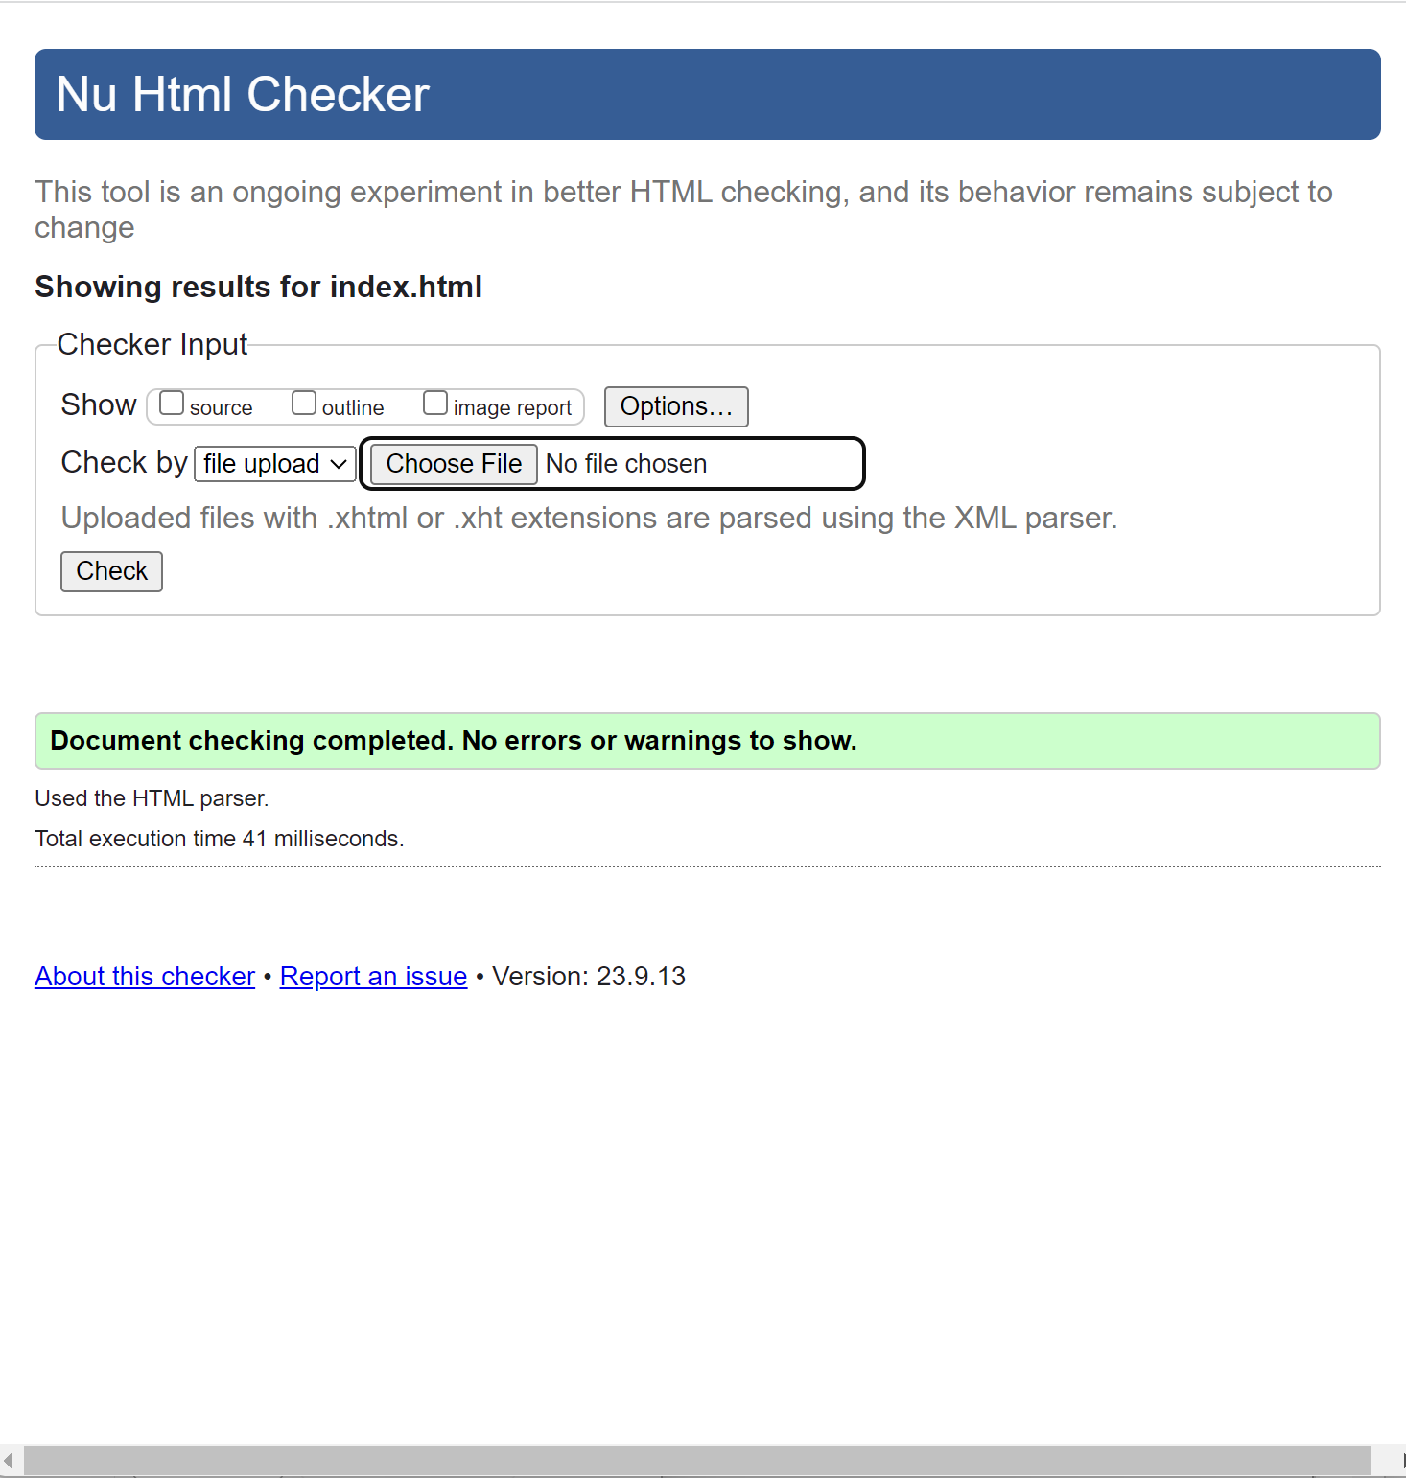
Accessibility - Code
Using the W3C HTML checking tool I was able to eradicate all accessibility issues with the HTML code that I created, following all of the guidance provided, including using semantic code.

Slide 15
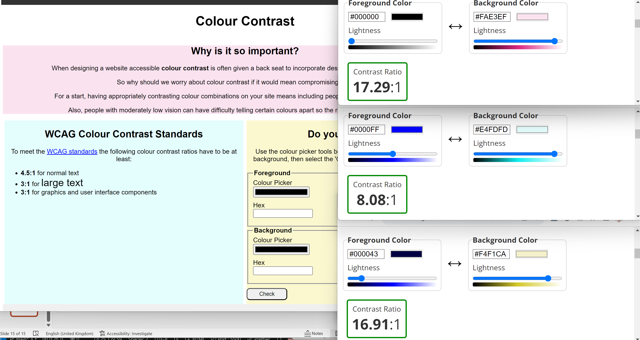
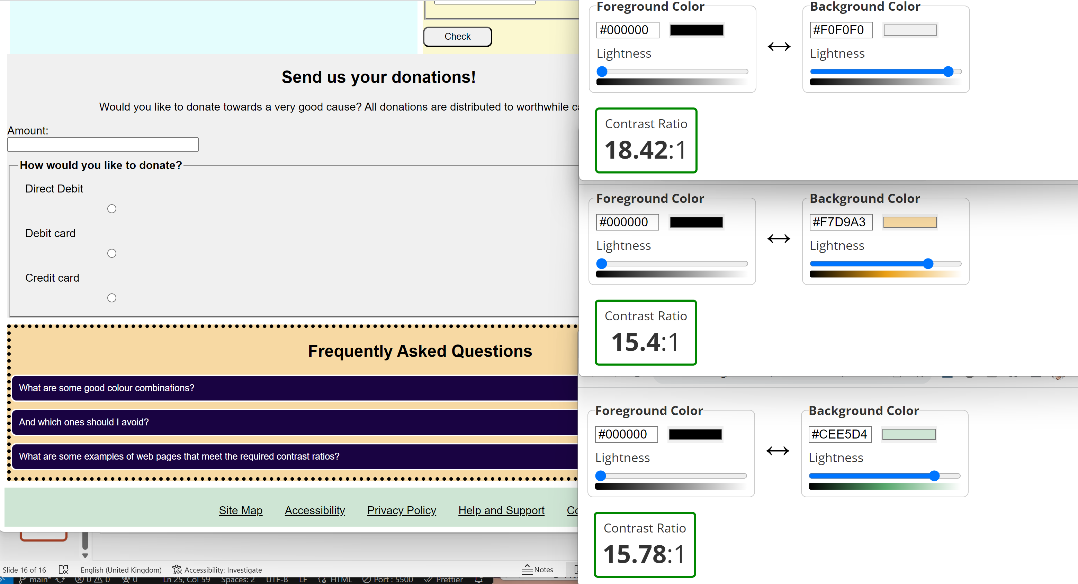
Accessibility – Colour Contrast
Colours on page were used with accessibility in mind, to ensure good contrast between text and background colour. I also used lighter shades to cause less strain on the eyes.

Slide 16
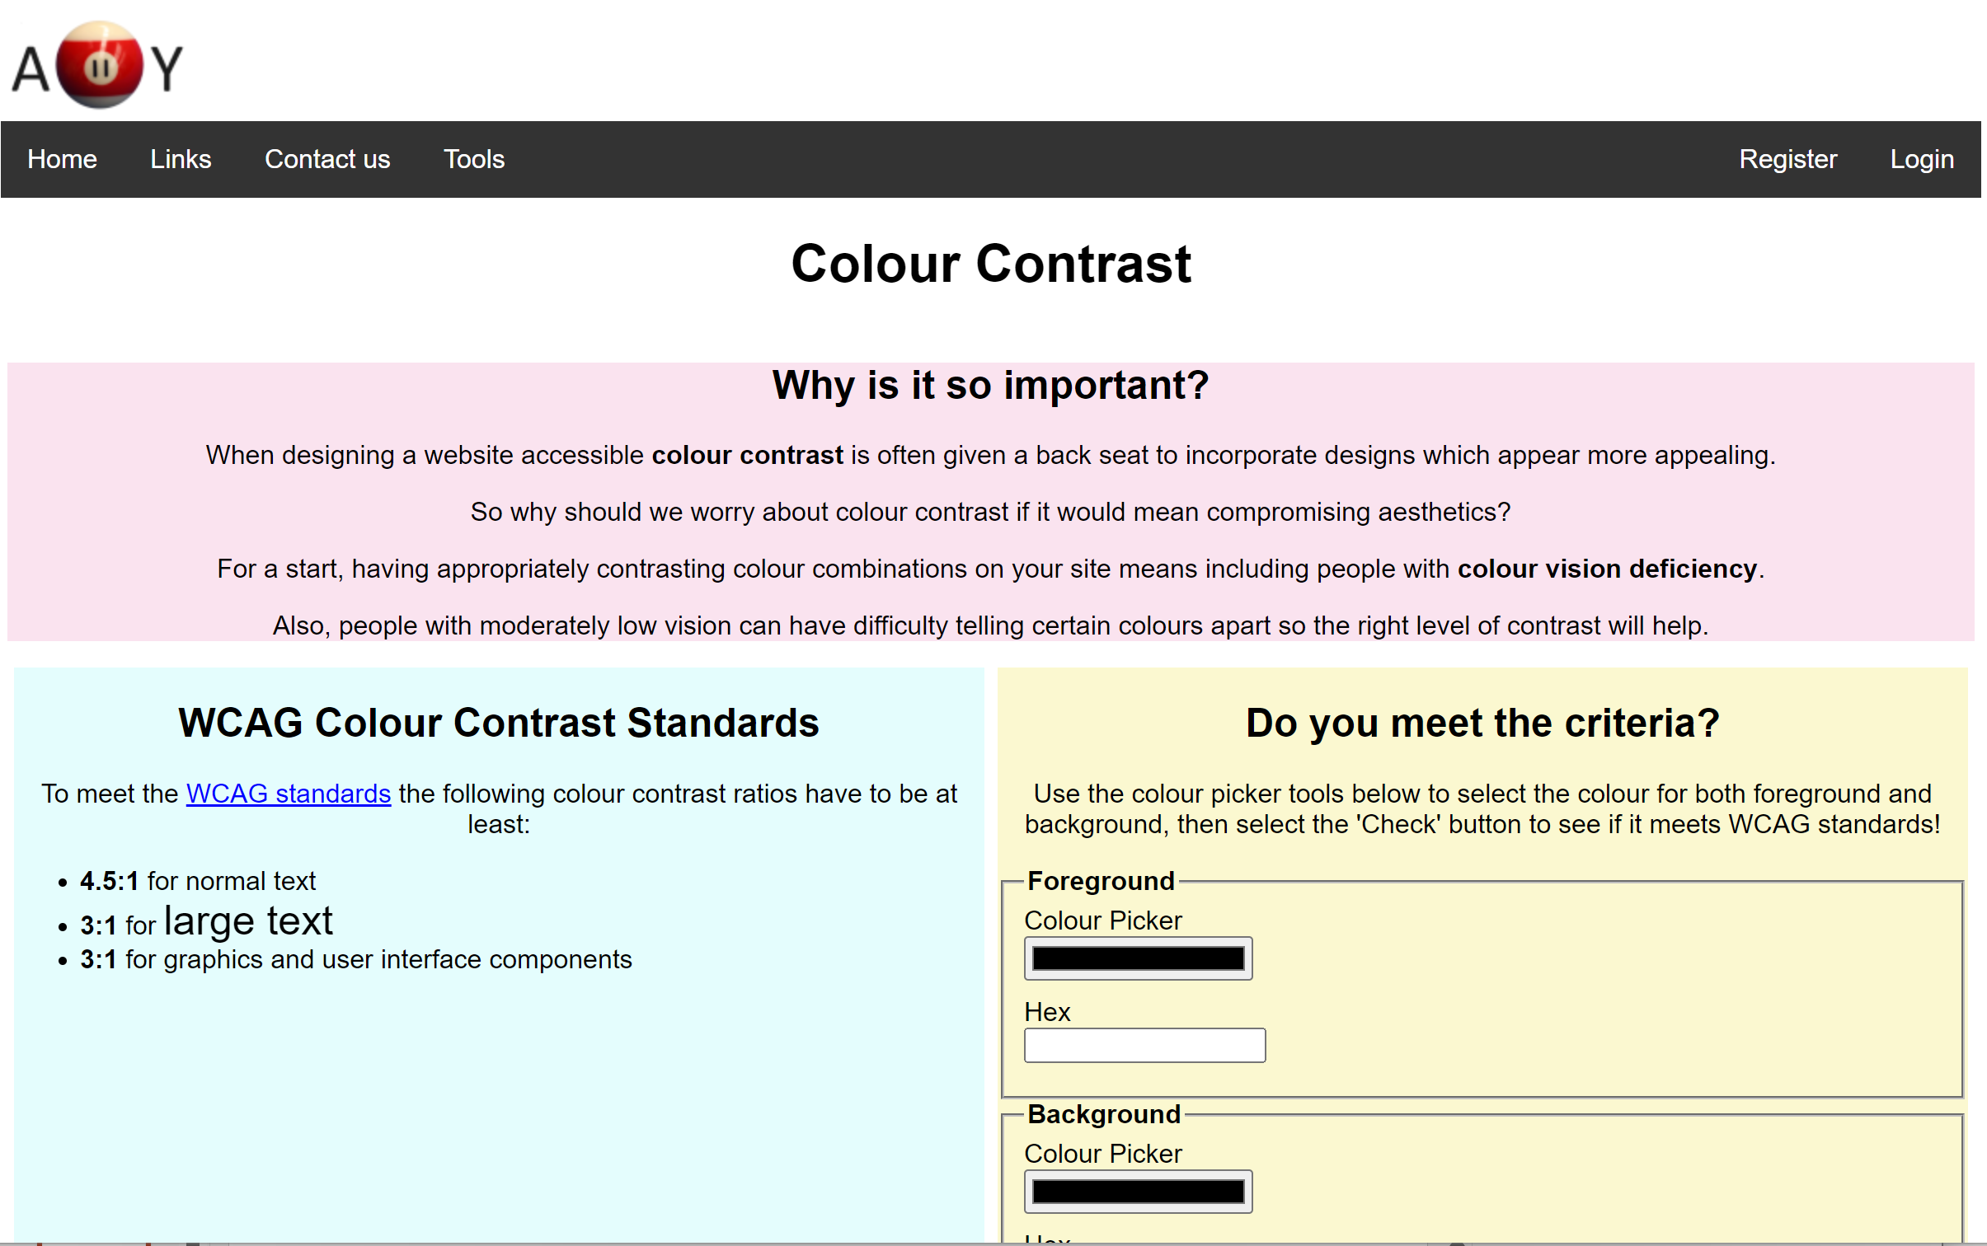
Accessibility - Font
Arial font used throughout webpage, as it is ‘sans serif’ and one of the more accessible fonts available. It has a high x-height, wide letter spacing, and a clear distinction between similar-looking characters. Arial is also compatible with accessibility readers and screen magnifiers.

Slide 17
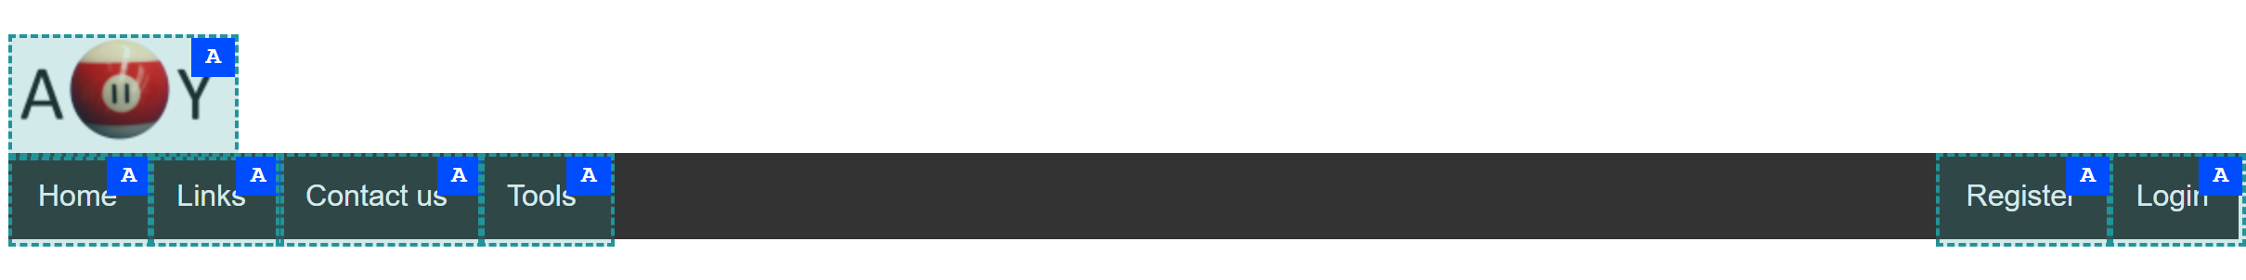
Accessibility – Link Area
Links have ample padding to allow for easier selection, especially for people with motor skills difficulties, as well as those with larger fingers.

Slide 18
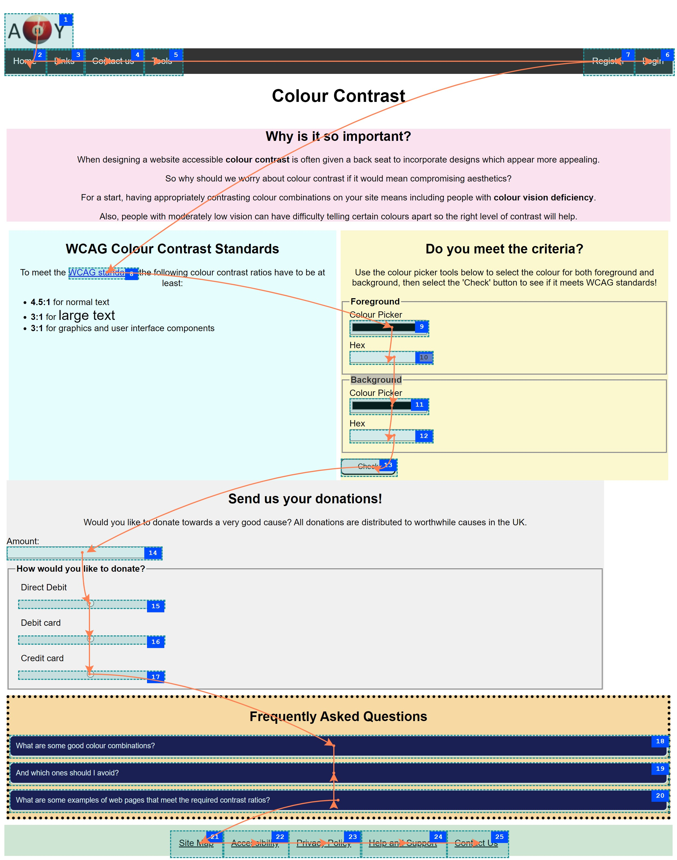
Accessibility – Tabbing Order
Tabbing and reading order goes top to bottom, left to right, in keeping with the expected behaviour for the English language. This helps the user as it means everything is where it is expected to be, and nothing behaves in a surprising manner.

Slide 19
Accessibility – Page Reflow
Content can be presented without loss of information or functionality, and without requiring scrolling in two dimensions.
Menubar and footer links change from row to column, with each section being stacked and text adapting to the smaller width.

Slide 20
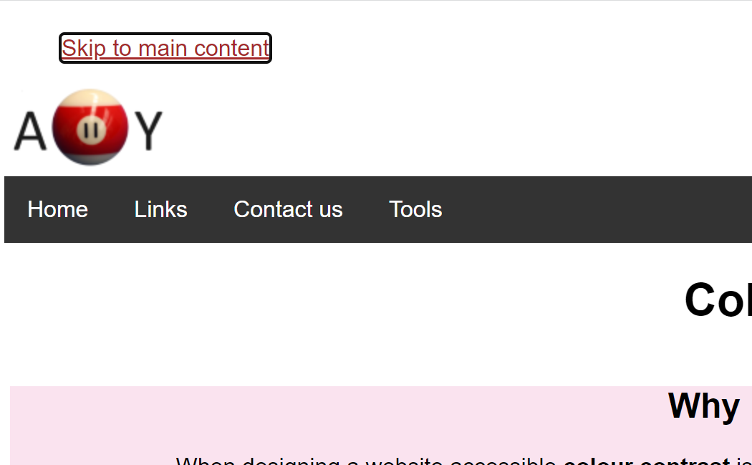
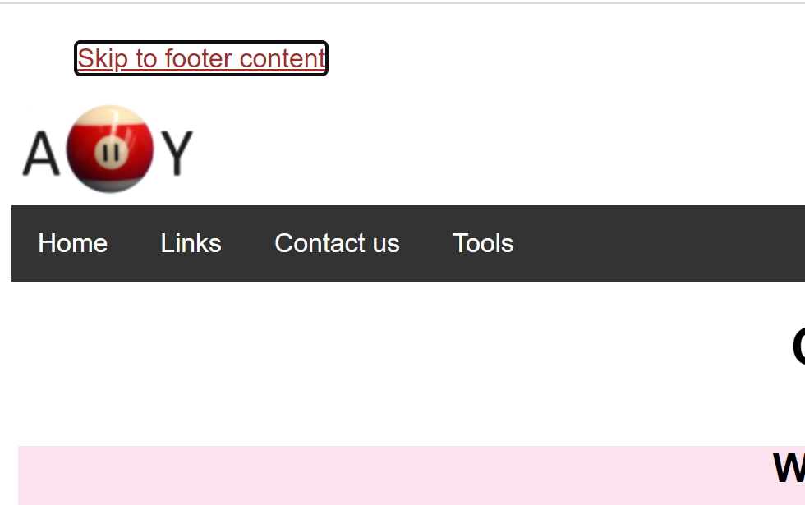
Accessibility – Skip Links
Skip links become visible and focusable only when tabbing onto them using the keyboard. This assists keyboard users who want to move straight onto the main or footer content without having to trawl through all the content before them.

Slide 21
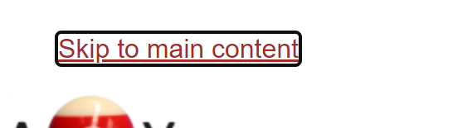

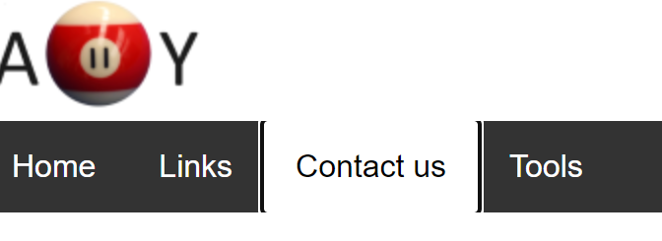
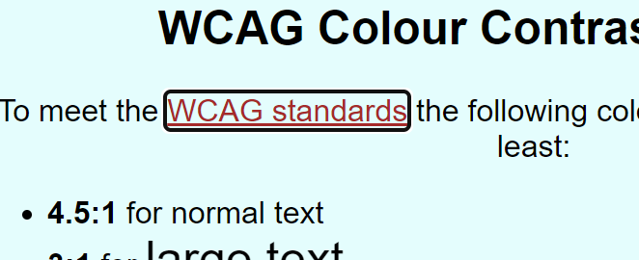
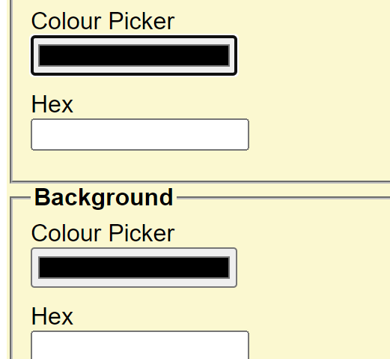
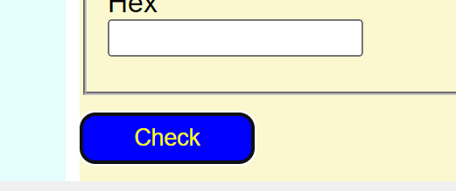
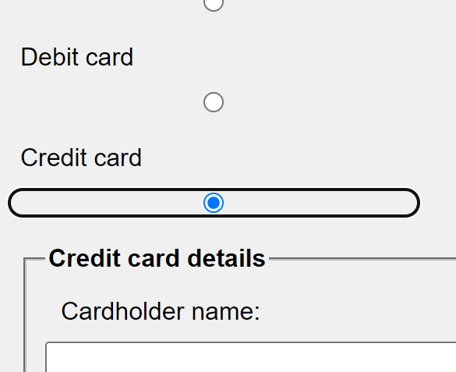
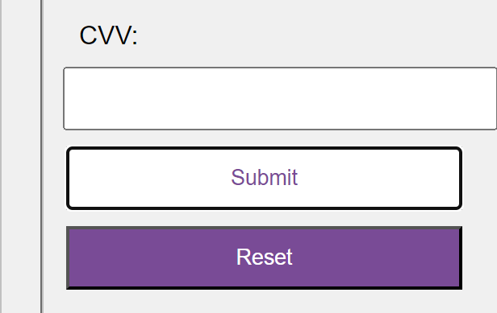
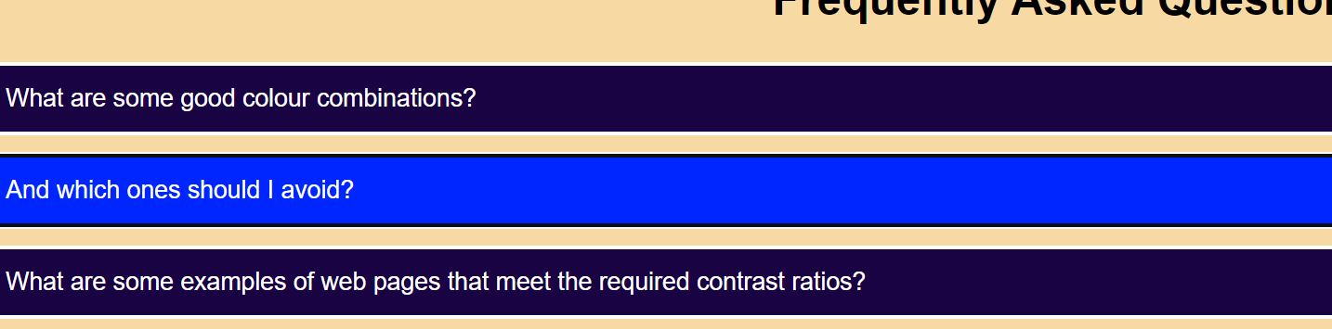
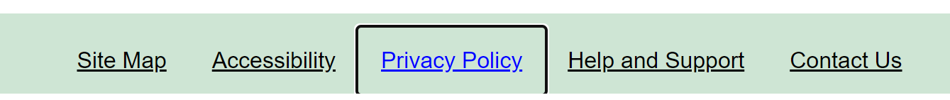
Accessibility – Visible Keyboard Focus

Slide 22
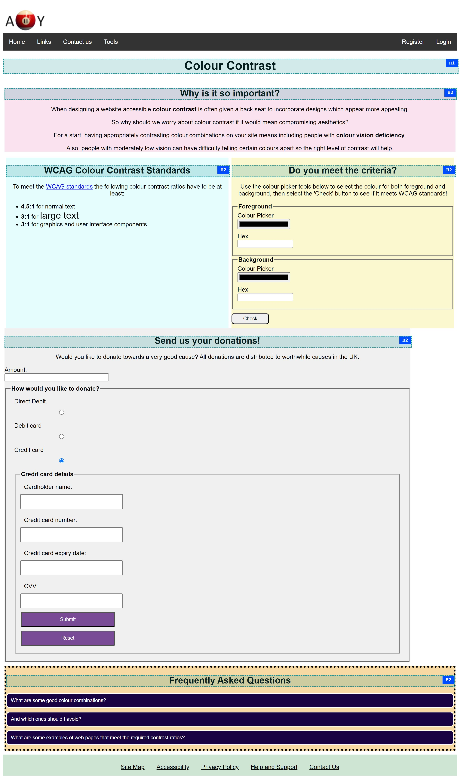
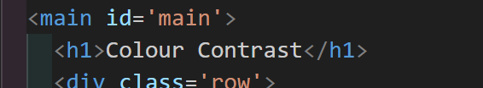
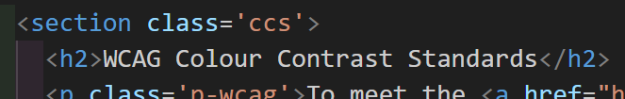
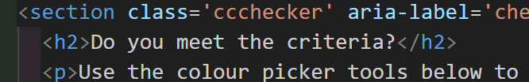
Accessibility - Headings
All headings on page have correct hierarchy, with the main heading at the top of the main body of content being H1, and the subsequent headings underneath all H2s.
Also, all headings have been coded semantically using the <H1> and <H2> elements.

Slide 23
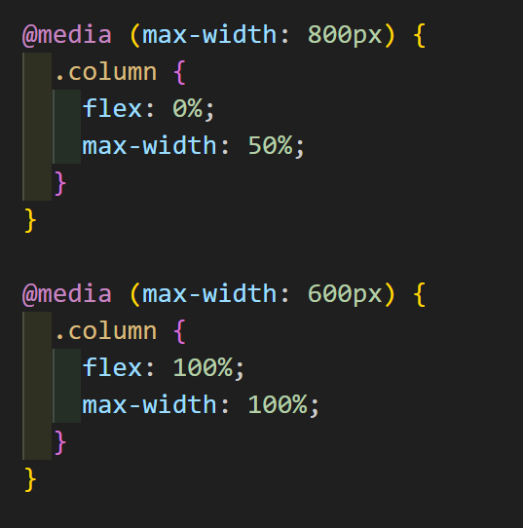
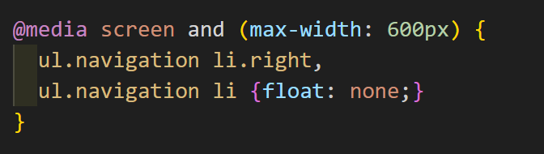
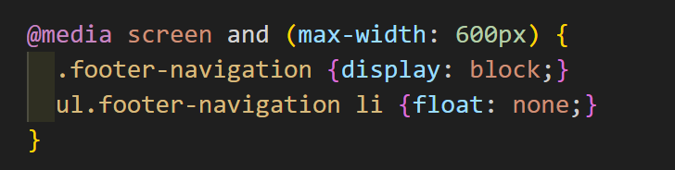
Media Queries

Slide 24
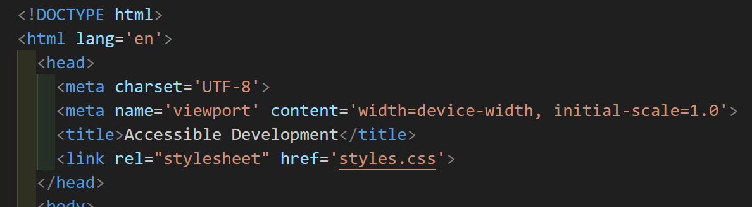
HTML <head>

Slide 25
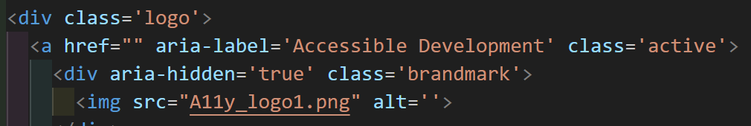
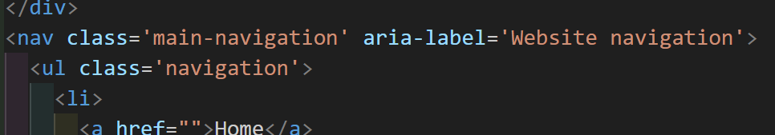
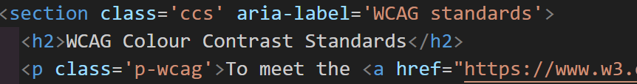
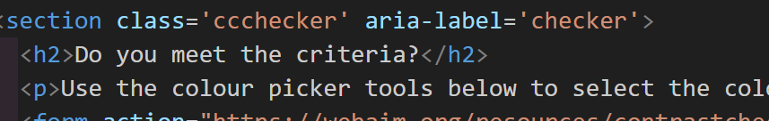
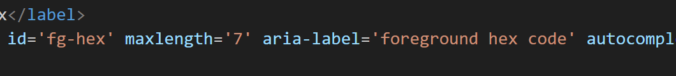
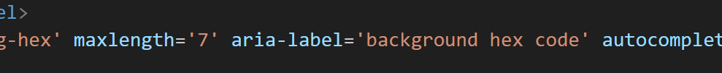
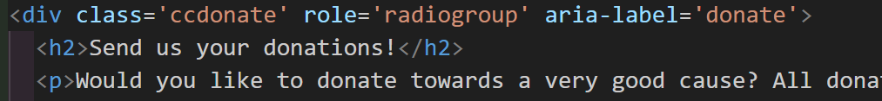
ARIA Labels

Slide 26
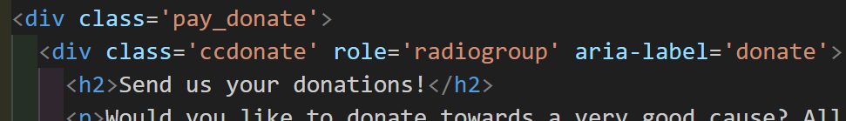
ARIA Role
When thinking of aria-role to use it was difficult as most are superceded by semantic HTML elements, e.g. heading, list etc. However I was able to use Radiogroup without it causing any accessibility issues.

Slide 27
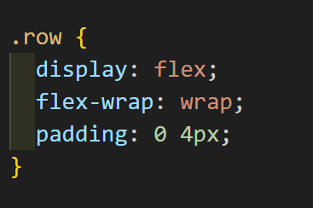
CSS Flex
I have incorporated flexbox into CSS code, however there is still a lot for me to learn on this as I have struggled to get the proportions correct for the widths of boxes in the container. I utilised Google and other search engines a lot while searching for a way to get this to work as I wanted, and given more time I’m sure I could get it to show correctly.

Slide 28
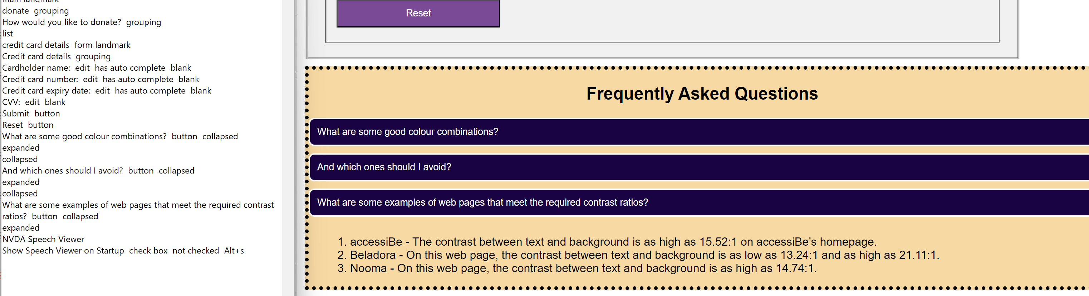
Accordions
The above screenshot shows the accordion and the change in state being announced in the screen reader.

Slide 29


Accordion - HTML

Slide 30

Accordion CSS & JavaScript
The JavaScript code sets the variables acc and I, then defines their functions, where it listens for a click before setting to active. And sets out the collapsed and expanded values.

Slide 31
Thank you for listening!

